Slide 1

Crossing numbers of infinite graphs
Szeged, 2026
Éva Czabarka University of South Carolina
Alec Helm University of South Carolina
László Székely* University of South Carolina
Notes:
.

Slide 2
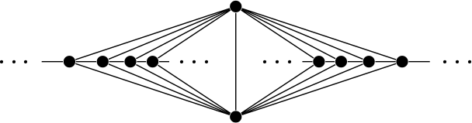
Infinite planar graphs
1930: Kuratowski’s theorem for finite graphs
1954: [Dirac and Shuster] Kuratowski’s theorem holds for countable graphs
1967: [Wagner] Kuratowski’s theorem for infinite graphs A graph G is planar iff G has at most continuum-many vertices and edges, it contains no subdivision of a K₅ or K_{3,3} and has only countably many vertices of degree three or more.
Finite maximal planar graphs are 3-connected
1977: [Thomassen] Infinite maximal planar graphs are 2-connected
Notes:
Definitions Dirac-Shuster Konig Lemma, Erdos, finite number of embeddings

Slide 3
Drawing infinite planar graphs
1948: [Fáry] Finite planar graphs admit rectilinear embeddings
1977: [Thomassen] Planar graphs admit rectilinear embeddings
New complications: vertex accumulation points (VAP) and edge accumulation points (EAP)
Infinite graphs can avoid edge accumulation points only if all degrees are finite, a.k.a. the graph is locally finite
Notes:
Surface generalization of 1977 open,

Slide 4
Avoiding accumulation points in drawings of infinite planar graphs
1966: [Halin] 1977: [Schmidt] 1989: [Halin] Kuratowski type classification of countable planar graphs with VAP-free/EAP-free embeddings

Slide 5
Infinite outerplanar graphs
Finite graph is outerplanar iff it is 1-page book embeddable
1967: [Chartrand and Harary] Kuratowski’s theorem for finite outerplanar graphs: outerplanar graphs are graphs that contain no subdivision of a K₄ or K_{2,3}
1994: [Boza, Diánez and Márquez] A countable locally finite outerplanar graph admits a VAP and EAP-free embedding if and only if it does not contain subdivisions of:
  3 one-way infinite paths starting at the same vertex;
  a 4-cycle with two one-way infinite paths starting at its opposite vertices.
Notes:
Definitions, Boza takes for granted Chartrand-Harary for countable graphs

Slide 6
Graphs with k-page drawings
1967: [Yannakakis] Finite planar graphs are 4-page embeddable
1979: [Bernhart and Kainen] A finite graph has a 2-page embedding precisely when it is a spanning subgraph of a planar Hamiltonian graph.
Notes:
Definitions Gail Atneosen, k-page drawing is not minor closed for k>1

Slide 7
New results on crossing numbers
countable compactness of crossing numbers
  Planar version
  k-page book version
  Surface version
Wagner type theorems for books and surfaces
Three new concepts of crossing numbers for infinite graphs
Notes:
Augmentation, torus

Slide 8
Countable compactness of planar crossing numbers
Theorem. Let k be a natural number. A countable multigraph has planar crossing number at most k iff all of its finite submultigraphs have crossing number at most k .
k=0 is embeddability, i.e., Dirac-Schuster
Key to the proof is that finite planar graphs have finitely many embeddings, up to homeomorphisms

Slide 9
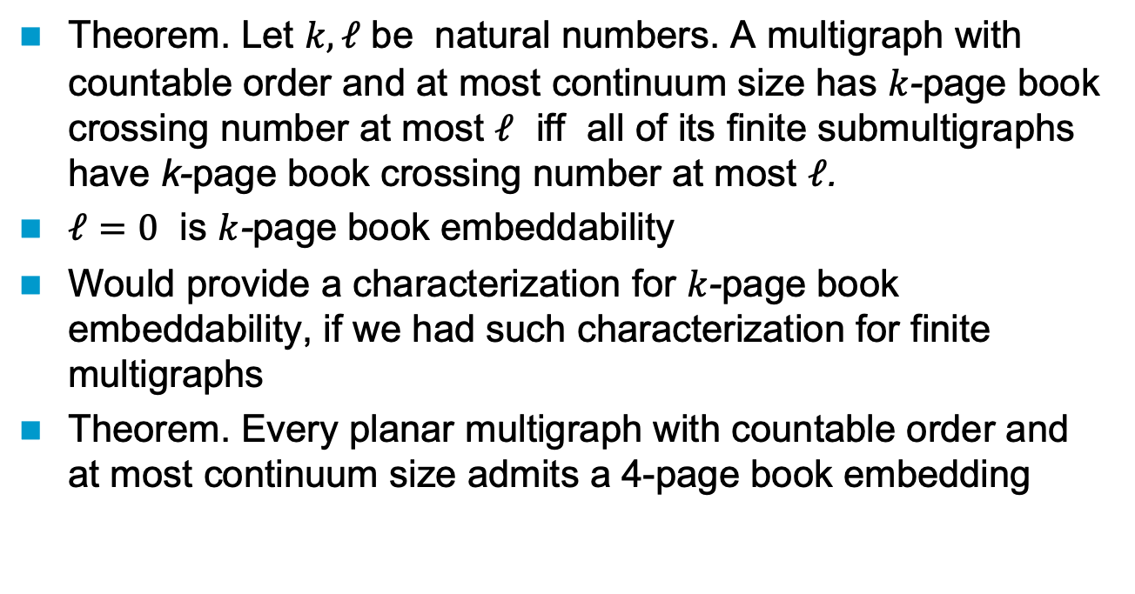
Countable compactness of book crossing numbers
Theorem. Let $k, ℓ$ be natural numbers. A multigraph with countable order and at most continuum size has $k$-page book crossing number at most $ℓ$ iff all of its finite submultigraphs have k-page book crossing number at most $ℓ$.
$ℓ=0$ is $k$-page book embeddability
Would provide a characterization for $k$-page book embeddability, if we had such characterization for finite multigraphs
Theorem. Every planar multigraph with countable order and at most continuum size admits a 4-page book embedding

Slide 10
Wagner type theorems for books
Theorem. A multigraph has an outerplanar embedding if and only if it has at most continuum many edges and vertices, countably many vertices of degree at least 2, and it contains no subdivisions of a K₄ or K_{2,3}
Theorem. A multigraph with countable order and at most continuum size admits a 2-page book embedding if and only if all of its finite subgraphs can be extended into a planar Hamiltonian graph by adding edges.
Theorem. Continuum many disjoint even cycles embed in the 2-page book. Uncountably many odd cycles do not embed in the k-page book, for any k.

Slide 11
Countable compactness of crossing numbers on surfaces
2025: [Georgakopoulos] Let S be a compact orientable surface. A countable graph has an embedding in S iff all of its finite subgraphs have.
Theorem. Let S be a compact surface and k a natural number. A connected countable multigraph can be drawn with at most k crossings on S iff all of its finite submultigraphs can be drawn with at most k crossings on S. (connectedness is only needed for non-orientable surfaces)

Slide 12
Wagner type theorems for surfaces
Robertson-Seymour theory implies that finite graphs embeddable into a fixed compact surface have excluded topological minor characterization.
2025: [Georgakopoulos] Let S be a compact orientable surface. A countable graph has an embedding in S iff all of its finite subgraphs have.
Theorem. A connected multigraph has an embedding on a compact orientable surface if and only if it has at most continuum many edges and vertices, has countably many vertices of degree at least three, and all of its finite submultigraphs have an embedding in the surface. (Last condition can be reformulated in terms of excluded topological minors.)

Slide 13
Three new concepts of crossing numbers for plane drawings of infinite graphs
cr_{VAP} cr_{EAP} cr_{CAP} where vertex/edge/crossing point accumulation is forbidden in the drawing
These are not always well-defined
Theorem. These 3 new crossing number concepts are distinct from each other and from cr
Theorem. If two of these crossing numbers are defined, then the respective inequality of this chain holds for them:
cr(G) ≦ cr_{CAP}(G) ≦ cr_{VAP}(G) ≦ cr_{EAP}(G)
Notes:
Next to last: fixed t for a larder range!

Slide 14


