Slide 1
Curious crossing critical edges: variations on an example of Širáň
Éva Czabarka
Joint work with Alec Helm

Slide 2
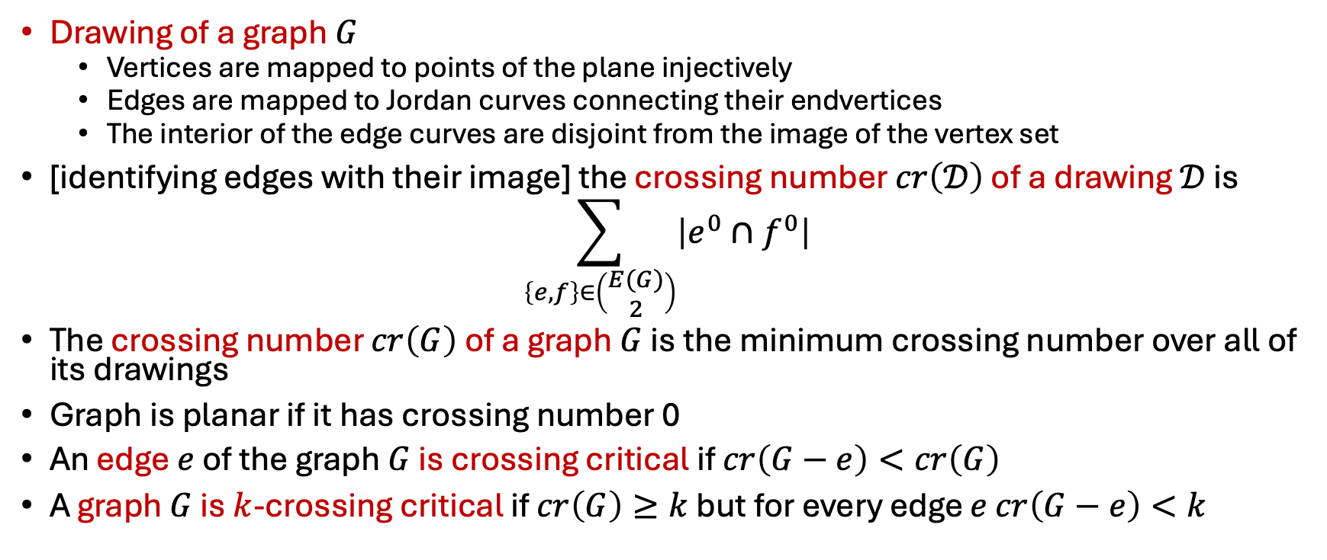
Basic definitions
Drawing of a graph $G$
  Vertices are mapped to points of the plane injectively
  Edges are mapped to Jordan curves connecting their endvertices
  The interior of the edge curves are disjoint from the image of the vertex set
[identifying edges with their image] the crossing number $cr\left(𝒟\right)$ of a drawing $𝒟$ is
$$\sum_{\left\{e,f\right\}∈\left(\begin{matrix}E(G) \\ 2\end{matrix}\right)}{\left|e^{0}∩f^{0}\right|}$$
The crossing number $cr\left(G\right)$ of a graph $G$ is the minimum crossing number over all of its drawings
Graph is planar if it has crossing number 0
An edge $e$ of the graph $G$ is crossing critical if $cr\left(G−e\right)<cr\left(G\right)$
A graph $G$ is $k$-crossing critical if $cr\left(G\right)≥k$ but for every edge $e$ $cr\left(G−e\right)<k$

Slide 3
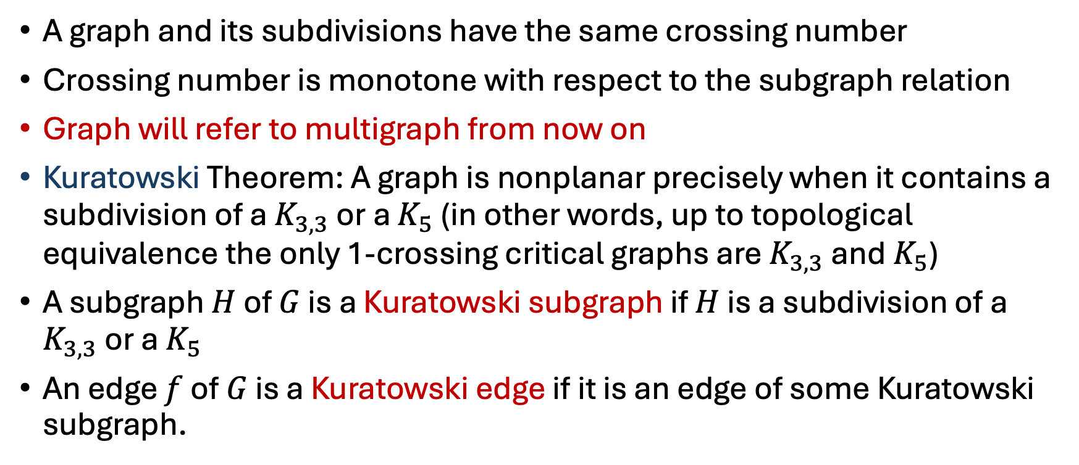
Quick review
A graph and its subdivisions have the same crossing number
Crossing number is monotone with respect to the subgraph relation
Graph will refer to multigraph from now on
Kuratowski Theorem: A graph is nonplanar precisely when it contains a subdivision of a $K_{3,3}$ or a $K_{5}$ (in other words, up to topological equivalence the only 1-crossing critical graphs are $K_{3,3}$ and $K_{5}$)
A subgraph $H$ of $G$ is a Kuratowski subgraph if $H$ is a subdivision of a $K_{3,3}$ or a $K_{5}$
An edge $f$ of $G$ is a Kuratowski edge if it is an edge of some Kuratowski subgraph.

Slide 4
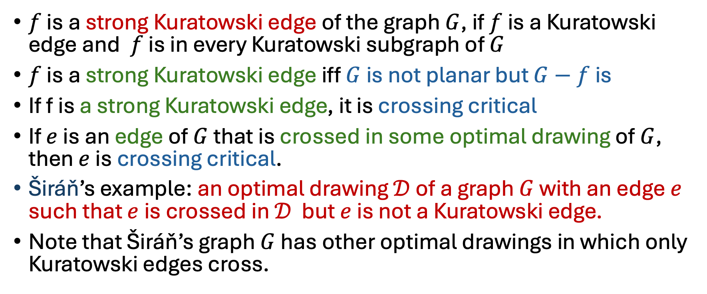
Quick review
$f$ is a strong Kuratowski edge of the graph $G$, if $f$ is a Kuratowski edge and $f$ is in every Kuratowski subgraph of $G$
$f$ is a strong Kuratowski edge iff $G$ is not planar but $G−f$ is
If f is a strong Kuratowski edge, it is crossing critical
If $e$ is an edge of $G$ that is crossed in some optimal drawing of $G$, then $e$ is crossing critical.
Širáň’s example: an optimal drawing $𝒟$ of a graph $G$ with an edge $e$ such that $e$ is crossed in $𝒟$ but $e$ is not a Kuratowski edge.
Note that Širáň’s graph $G$ has other optimal drawings in which only Kuratowski edges cross.

Slide 5
Širán’s example
Notes:
F is strong Kuratowski (removal creates planar), e is non-Kuratowski, yellow drawing is “only” optimal with e crossed, plenty of other optimal drawings, in some f is not crossed.

Slide 6

Questions
Answer to each is NO
Our proof uses modifications of the Širáň graph
For the Širán graph:
  We have optimal drawings in which the edge $e$ (that is not a Kuratowski edge) is crossed, therefore it is crossing-critical (but $e$ is not crossed in every optimal drawing)
  We have optimal drawings in which the strong Kuratowski edge $f$ (which is crossing critical) is not crossed (but $f$ is crossed in other optimal drawings).
We consider the following questions:
  If an edge $e$ is crossed in every optimal drawing of a graph $G$, does it have to be a Kuratowski edge?
  If a graph $G$ has strong Kuratowski edges is there some optimal drawing in which some strong Kuratowski edge is crossed?
  If an edge $e$ is not crossed in any optimal drawing and is not a Kuratowski edge, can $e$ be crossing critical?

Slide 7
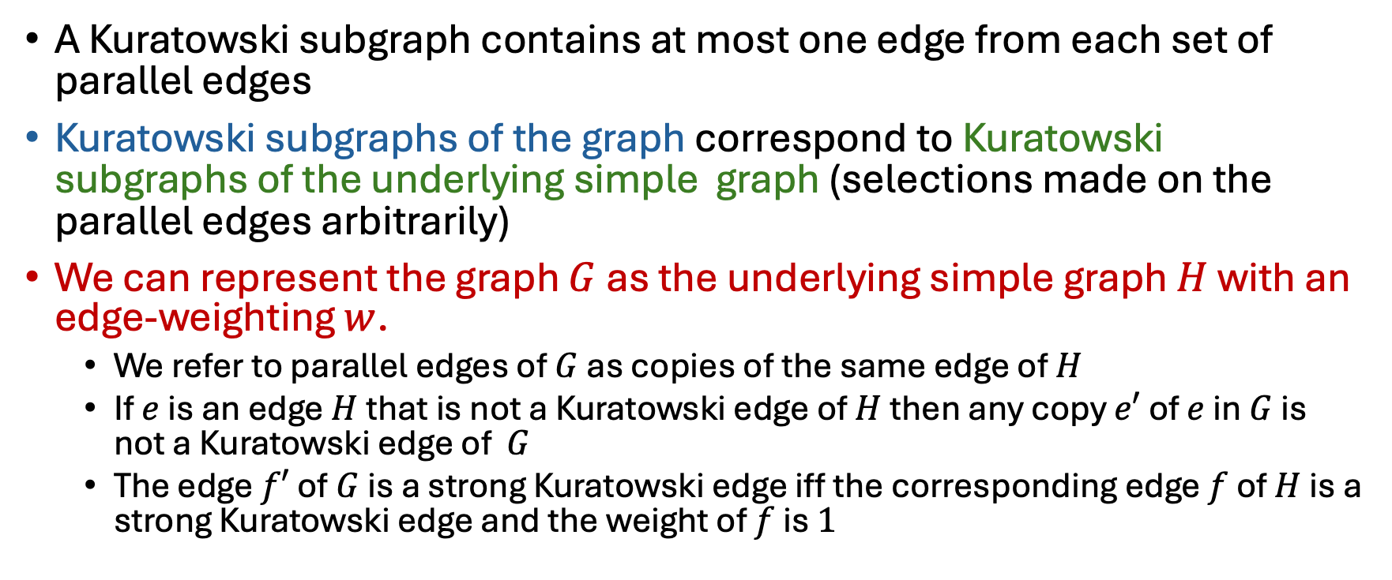
Finding Kuratowski subgraphs
A Kuratowski subgraph contains at most one edge from each set of parallel edges
Kuratowski subgraphs of the graph correspond to Kuratowski subgraphs of the underlying simple graph (selections made on the parallel edges arbitrarily)
We can represent the graph $G$ as the underlying simple graph $H$ with an edge-weighting $w$.
  We refer to parallel edges of $G$ as copies of the same edge of $H$
  If $e$ is an edge $H$ that is not a Kuratowski edge of $H$ then any copy $e′$ of $e$ in $G$ is not a Kuratowski edge of $G$
  The edge $f′$ of $G$ is a strong Kuratowski edge iff the corresponding edge $f$ of $H$ is a strong Kuratowski edge and the weight of $f$ is $1$

Slide 8

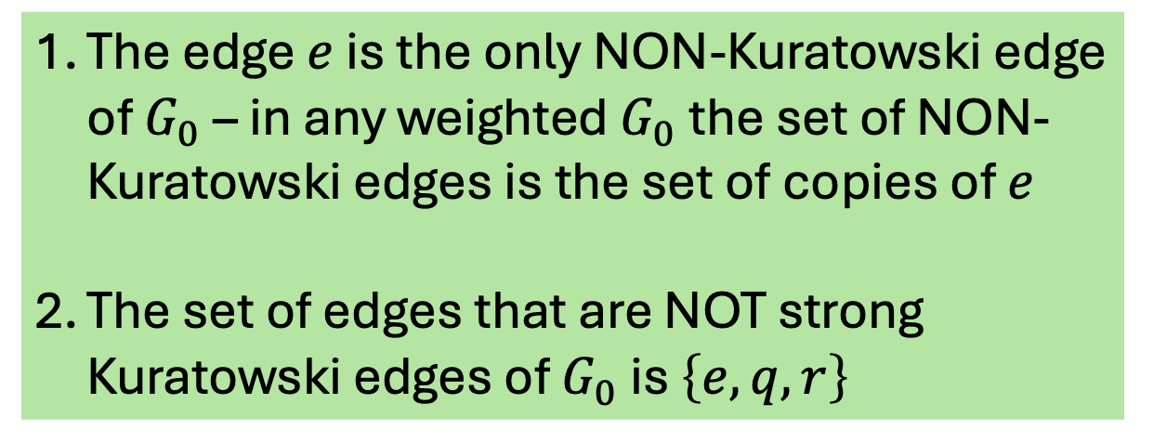
Finding Kuratowski subgraphs
No subdivided $K_{5}$ - too few degree $4$ vertices
Exactly one vertex removed or is a subdividing vertex
Neighbors of degree $3$ vertices can not be removed – we can only remove $v_{2}$ or $v_{4}$
Removal of $v_{2}$ or $v_{4}$ results in a 3-regular non-bipartite graph – so all subdivided $K_{3,3}$-s have a subdividing vertex
We must remove exactly 2 edges to get subdivided $K_{3,3}$
Removal of the $v_{1}v_{3}$ edge $f$ results in planar graph - $f$ must be in any topological $K_{3,3}$
We must remove $q$ or $r$ – otherwise we have a triangle
We must remove $e$ to get a subdivided $3$-regular graph
Two subdivided $K_{3,3}$-s: $G_{0}−\left\{e,q\right\}$ and $G_{0}−\left\{e,r\right\}$
The edge $e$ is the only NON-Kuratowski edge of $G_{0}$ – in any weighted $G_{0}$ the set of NON-Kuratowski edges is the set of copies of $e$
The set of edges that are NOT strong Kuratowski edges of $G_{0}$ is $\left\{e,q,r\right\}$
Notes:
E,f,g,h will be important later, only degree 4 vertioces u,t,s, the v_i are degree 3

Slide 9
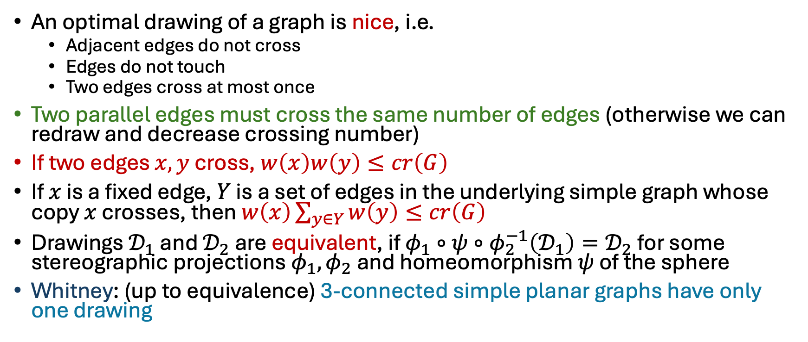
Optimal drawings of graphs
An optimal drawing of a graph is nice, i.e.
  Adjacent edges do not cross
  Edges do not touch
  Two edges cross at most once
Two parallel edges must cross the same number of edges (otherwise we can redraw and decrease crossing number)
If two edges $x,y$ cross, $w\left(x\right)w\left(y\right)≤cr\left(G\right)$
If $x$ is a fixed edge, $Y$ is a set of edges in the underlying simple graph whose copy $x$ crosses, then $w\left(x\right)\sum_{y∈Y}{w\left(y\right)≤cr\left(G\right)}$
Drawings $𝒟_{1}$ and $𝒟_{2}$ are equivalent, if $φ_{1}∘ψ∘φ_{2}^{−1}\left(𝒟_{1}\right)=𝒟_{2}$ for some stereographic projections $φ_{1},φ_{2}$ and homeomorphism $ψ$ of the sphere
Whitney: (up to equivalence) 3-connected simple planar graphs have only one drawing
Notes:
Redraw parallel copies is the right order for formulae: first x then all y

Slide 10
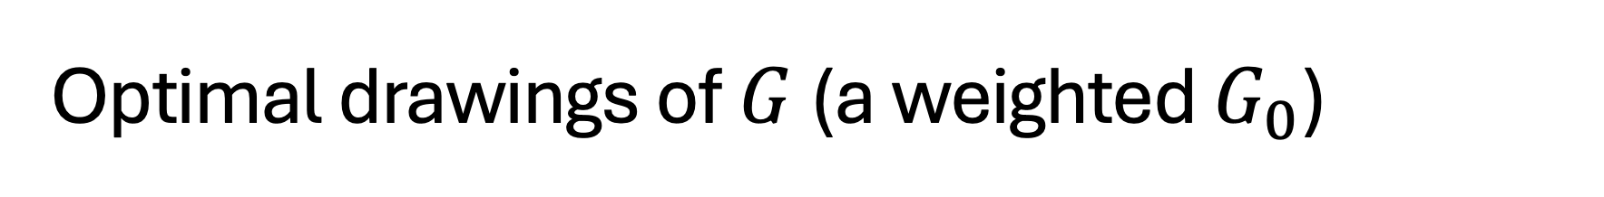
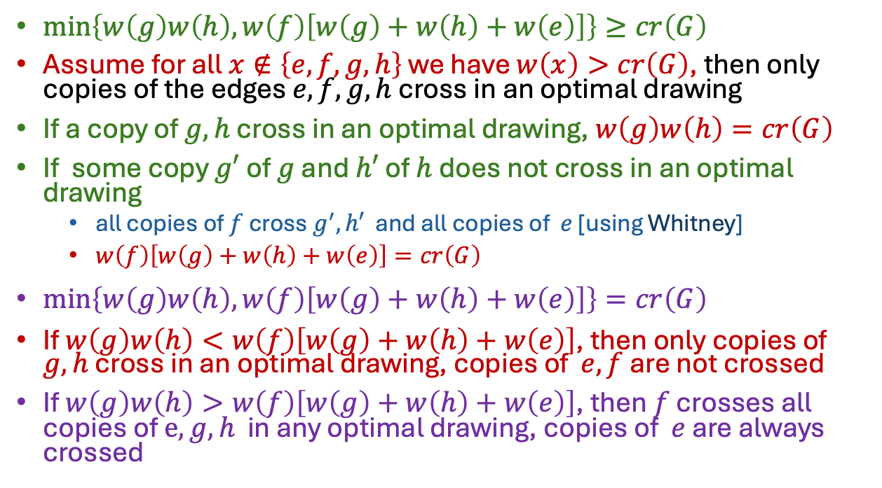
Optimal drawings of $G$ (a weighted $G_{0}$)
$\min\left\{w\left(g\right)w\left(h\right), w\left(f\right)\left[w\left(g\right)+w\left(h\right)+w\left(e\right)\right]\right\}≥cr\left(G\right)$
Assume for all $x∉\left\{e,f,g,h\right\}$ we have $w\left(x\right)>cr\left(G\right)$, then only copies of the edges $e,f,g,h$ cross in an optimal drawing
If a copy of $g,h$ cross in an optimal drawing, $w\left(g\right)w\left(h\right)=cr\left(G\right)$
If some copy $g′$ of $g$ and $h′$ of $h$ does not cross in an optimal drawing
  all copies of $f$ cross $g^{′},h′$ and all copies of $e$ [using Whitney]
  $w\left(f\right)\left[w\left(g\right)+w\left(h\right)+w\left(e\right)\right]=cr\left(G\right)$
$\min\left\{w\left(g\right)w\left(h\right),w\left(f\right)\left[w\left(g\right)+w\left(h\right)+w\left(e\right)\right]\right\}=cr\left(G\right)$
If $w\left(g\right)w\left(h\right)<w\left(f\right)\left[w\left(g\right)+w\left(h\right)+w\left(e\right)\right]$, then only copies of $g,h$ cross in an optimal drawing, copies of $e,f$ are not crossed
If $w\left(g\right)w\left(h\right)>w\left(f\right)\left[w\left(g\right)+w\left(h\right)+w\left(e\right)\right]$, then $f$ crosses all copies of $e, g,h$ in any optimal drawing, copies of $e$ are always crossed

Slide 11
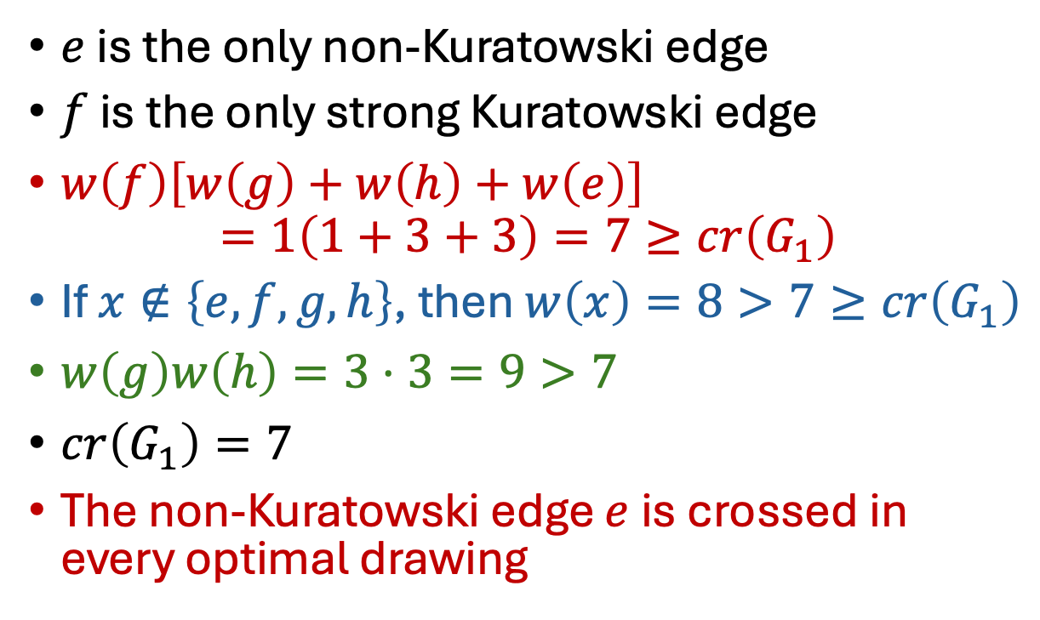
Non-Kuratowski edge crossed in every optimal drawing
$e$ is the only non-Kuratowski edge
$f$ is the only strong Kuratowski edge
$w\left(f\right)\left[w\left(g\right)+w\left(h\right)+w\left(e\right)\right]$
$=1\left(1+3+3\right)=7≥cr\left(G_{1}\right)$
If $x∉\left\{e,f,g,h\right\}$, then $w\left(x\right)=8>7≥cr\left(G_{1}\right)$
$w\left(g\right)w\left(h\right)=3⋅3=9>7$
$cr\left(G_{1}\right)=7$
The non-Kuratowski edge $e$ is crossed in every optimal drawing

Slide 12
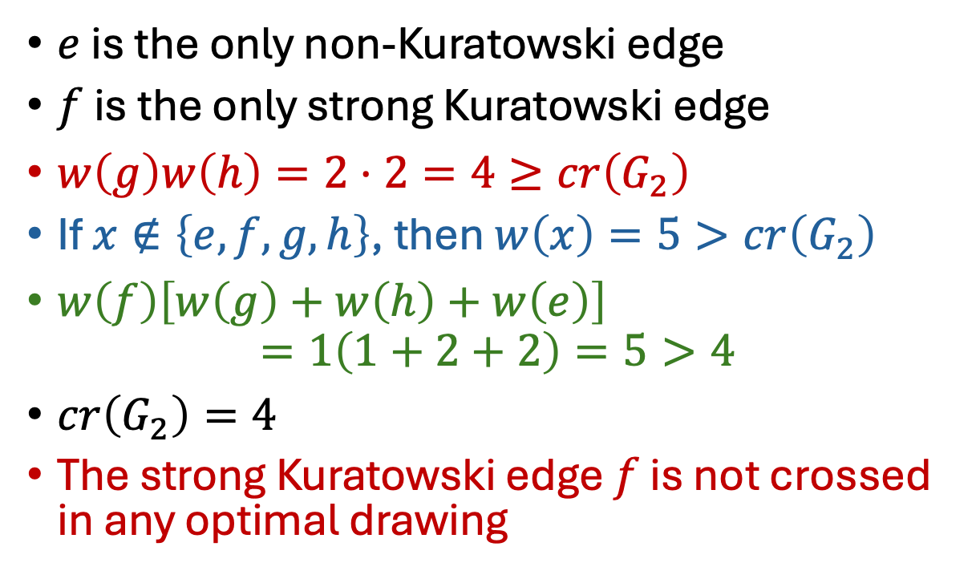
Strong Kuratowski edges are not crossed in any optimal drawing
$e$ is the only non-Kuratowski edge
$f$ is the only strong Kuratowski edge
$w\left(g\right)w\left(h\right)=2⋅2=4≥cr\left(G_{2}\right)$
If $x∉\left\{e,f,g,h\right\}$, then $w\left(x\right)=5>cr\left(G_{2}\right)$
$w\left(f\right)\left[w\left(g\right)+w\left(h\right)+w\left(e\right)\right]$
$=1\left(1+2+2\right)=5>4$
$cr\left(G_{2}\right)=4$
The strong Kuratowski edge $f$ is not crossed in any optimal drawing

Slide 13
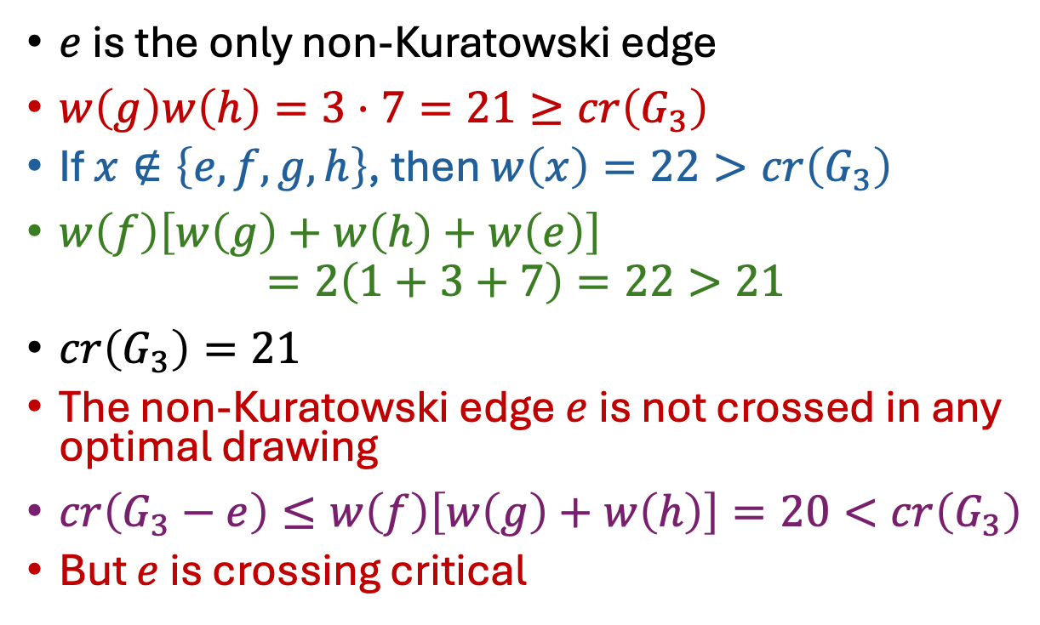
Non-Kuratowski edge is not crossed in any optimal drawing but is crossing critical
$e$ is the only non-Kuratowski edge
$w\left(g\right)w\left(h\right)=3⋅7=21≥cr\left(G_{3}\right)$
If $x∉\left\{e,f,g,h\right\}$, then $w\left(x\right)=22>cr\left(G_{3}\right)$
$w\left(f\right)\left[w\left(g\right)+w\left(h\right)+w\left(e\right)\right]$
$=2\left(1+3+7\right)=22>21$
$cr\left(G_{3}\right)=21$
The non-Kuratowski edge $e$ is not crossed in any optimal drawing
$cr\left(G_{3}−e\right)≤w\left(f\right)\left[w\left(g\right)+w\left(h\right)\right]=20<cr\left(G_{3}\right)$
But $e$ is crossing critical

Slide 14
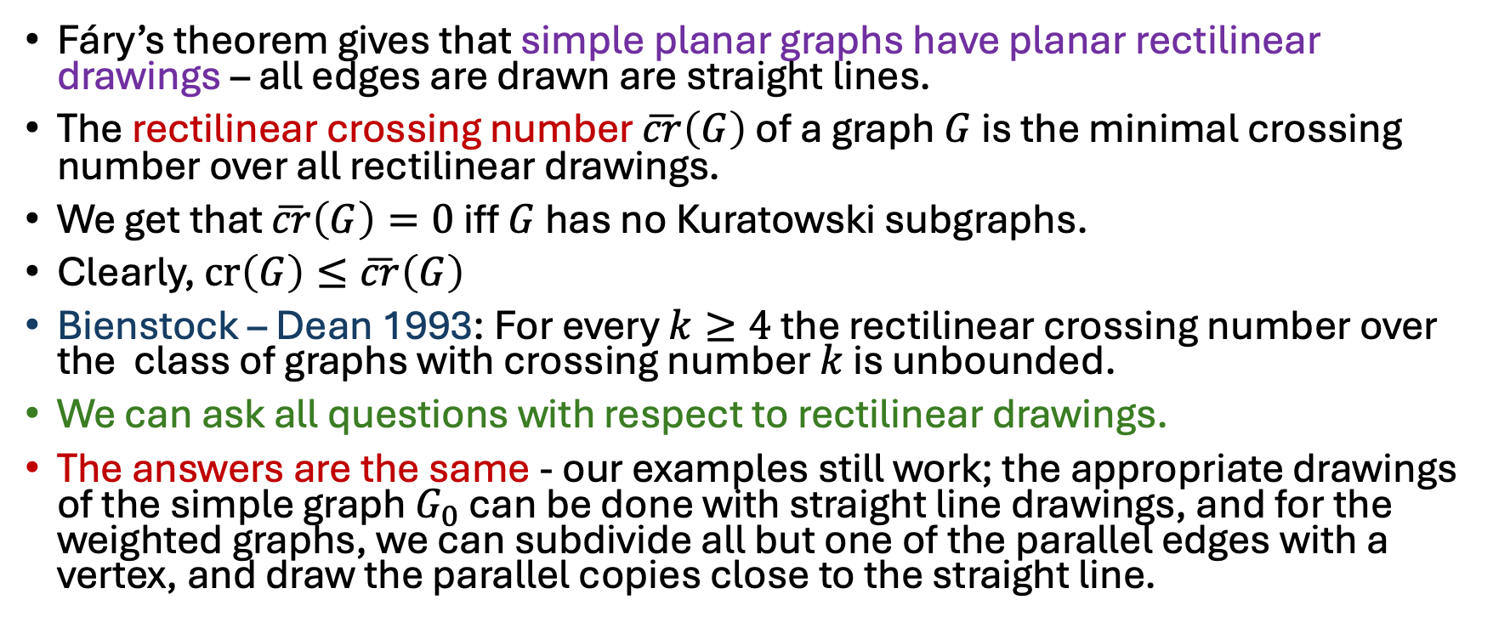
Remarks
Fáry’s theorem gives that simple planar graphs have planar rectilinear drawings – all edges are drawn are straight lines.
The rectilinear crossing number $\overline{cr}\left(G\right)$ of a graph $G$ is the minimal crossing number over all rectilinear drawings.
We get that $\overline{cr}\left(G\right)=0$ iff $G$ has no Kuratowski subgraphs.
Clearly, $cr\left(G\right)≤\overline{cr}\left(G\right)$
Bienstock – Dean 1993: For every $k≥4$ the rectilinear crossing number over the class of graphs with crossing number $k$ is unbounded.
We can ask all questions with respect to rectilinear drawings.
The answers are the same - our examples still work; the appropriate drawings of the simple graph $G_{0}$ can be done with straight line drawings, and for the weighted graphs, we can subdivide all but one of the parallel edges with a vertex, and draw the parallel copies close to the straight line.

Slide 15
